Slide 1

Software Testing
Unit 2
Integration Testing
Prof Raghu B. A. Rao
Department of Computer Science and Engineering
‹#›
‹#›

Slide 2

Introduction
“We are lucky to find errors in our testing.
Because, it is so much better than customer finding it”

Slide 3
Structural Testing
List of Contents
Integration Testing: Overview
Stubs & Harnesses
Top-down Integration
Bottom-up Integration
Bi-directional Integration
Incremental Integration
System (Big Bang Integration)
Department of Computer Science and Engineering

Slide 4
What is Integration Testing?
Integration: the act, or process or an instance of integrating
Integrate: to form, coordinate or blend into a functioning or unified whole
Typically a software system is made of several “blocks”. These blocks are “integrated” to form a whole system.
Integration testing means testing a partially built system.
With the idea of ?

Slide 5
What is Integration Testing?
As Testing Type
Based on Target - “ What”
Testing of units / components/ modules after integrating them together – at any level
Once integrated, appropriate technique (“How” ) is used to test
As Testing Phase
Since this activity is an important intermediate stage in STLC that needs special focus

Slide 6
Need for Integration Testing
Integration testing uncovers inter-component interface and functional problems.
Potential problems with external interfaces can be identified at earlier stage
Since one deals with partially built system, some of the system-level problems could be discovered at earlier stage

Slide 7
Integration Testing - An Overview
Concept is driven by
Software making process
Software complexity
Software/Technology solution Marketplace

Slide 8
Integration Testing - Errors
Errors that are caught in Integration testing
Interface mismatch – Parameters / return value – order, type and other semantics
Missing interfaces
Service invocation protocol mismatch
Error handling across the interfaces
Errors due to deployed environment
Initializations, closures
Configuration errors
Errors related to “emergent properties” are not caught this way.

Slide 9
Integration Testing - Errors
Error manifestations
Direct system messages
“… Not found”, “… wrong parameter…”
“..Contact System administrator”
Functional misbehavior
Run-time errors
May not manifest / detect also

Slide 10
Integration Testing - Testing of Interfaces
Internal interfaces
The interfaces that are provided for use by other devs / components
Provides communication across two or more modules
Not exposed to the customers
Needs complete understanding of design & architecture
External interfaces
The interfaces provided for use by other system/products
Used by third-party developers, solution providers
You need to understand why they are provided and how they can be used
APIs / SDKs / scripts / queries / dynamically created scripts / Web services

Slide 11
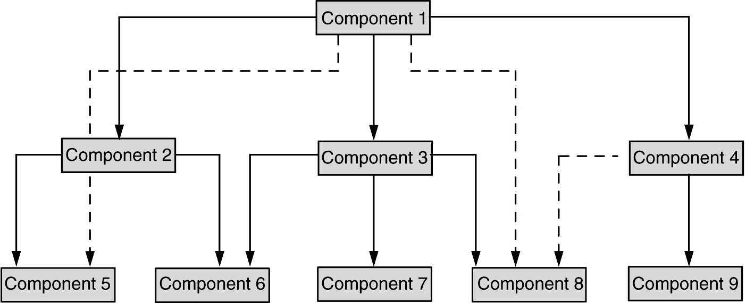
Integration Testing - Testing of Interfaces

Slide 12
Integration Testing - Methods
Integration sequence depends on a number of factors:
Test strategy
Project plan compulsions
Dev methodology – agile / spiral…
Actual project progress
External / customer dependency
Testing Resource availability
Testing method?

Slide 13
Integration Testing - Methods
Integration sequence depends on a number of factors:
Test strategy
Project plan compulsions
Dev methodology – agile / spiral…
Actual project progress
External / customer dependency
Testing Resource availability
Testing method?
A systematic approach
Top down
Bottom up
Bi-Directional
System Integration
All are incremental – except System Integration

Slide 14
Stubs & Drivers
Stubs are program units that are stand-instruction for the other(more complex) program units that are directly referenced by the unit being tested
It provides an Interface that is identical to the interface that will be provided by the actual program unit, and the minimum acceptable behavior expected of the actual program unit (a return statement in a function)
Very much needed to test the dependent program units till this unit is not ready
Drivers are programs or tools that allow a tester to exercise/examine in a controlling manner the unit of software being tested.
It provides a means of defining, declaring or otherwise creating, any variables, constants or other items needed in the testing of the unit and a means of monitoring the states of these items, any input and output mechanisms needed in the testing of unit.
“Test Harnesses”

Slide 15
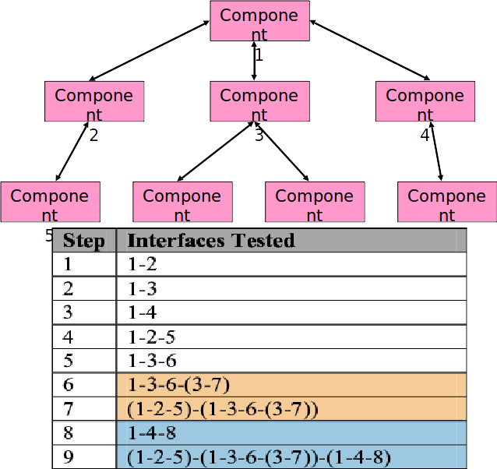
Top Down Integration

Slide 16
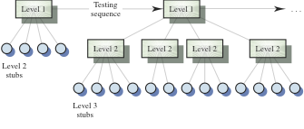
Highest Levels are Integrated First

Slide 17
Issues in Top Down Integration
If some unit/component not available, “stub” required
Some parts may be treated as sub-system
Breadth first – depth first

Slide 18
Top Down Integration
Advantages:
High-level logic and data flow is tested early in the process.
It tends to minimize the need for drivers.
Early skeletal program allows demonstration of click-thru prototype and boosts morale of developers and end users.
The coverage of test cases improve without any changes as new modules are added at the bottom.
Disadvantages:
Need for stubs complicates testing effort.
Difficult to observe the flow of data.
Low-level utilities are tested relatively late in the development cycle.
Since low level functions are not needed upfront, they may be designed at later stage which is not a good practice.
Poor support for early release of limited functionality.

Slide 19
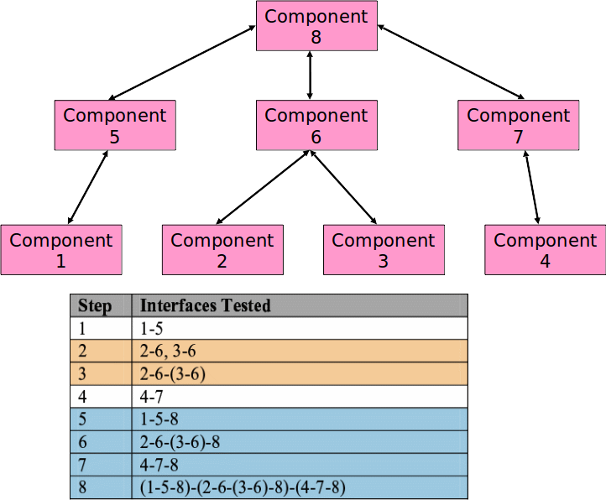
Bottom Up Integration

Slide 20
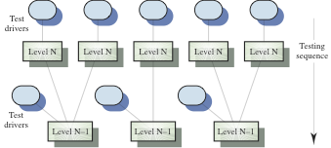
Bottom Up Integration

Slide 21
Issues in Bottom Up Integration
Quite suited for agile kind of methodologies
If some unit/component not available, “stub” required
From quality perspective, better approach as the ‘leaf nodes’ get tested many times.

Slide 22
Bottom Up Integration
Advantages:
Utility modules are tested early in the development process
Need for stubs is minimized
It is easier to observe the flow of data
Disadvantages:
Need for drivers complicates testing efforts
High-level logic and data flow are tested late
A demonstrable program can be created only after last (top) module is added
Many loose integration segments to be managed
Like the top-down approach, the bottom-up approach also provides poor support for early release of limited functionality

Slide 23
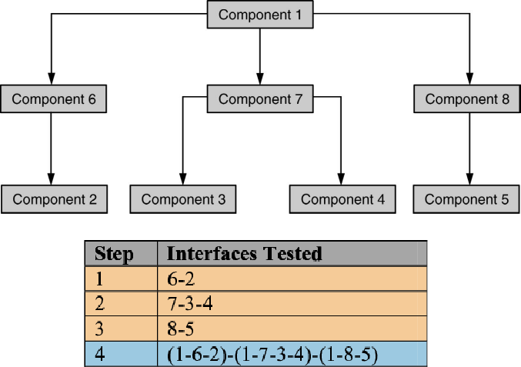
Bidirectional Integration

Slide 24
Bidirectional Integration
Combination of Top-down & Bottom up.
Individual components are separately tested.
Bi-Direction integration is done with use of Drivers & Stubs.
Drive - Upstream connectivity.
Stubs - Downstream connectivity.
Drivers & stubs are discarded after integration testing.
Sandwich Integration - is the combination of bottom-up approach and top-down approach, so it uses the advantage of both bottom up approach and top down approach. Initially it uses the stubs and drivers where stubs simulate the behaviour of missing component.

Slide 25
Incremental Integration
Advantages:
Programming errors related to mismatching interfaces or incorrect assumptions among modules will be detected earlier.
Debugging is easier.
It offers more flexibility.
It enables more efficient use of resources.
Both technically and managerially this is preferred to “big-bang” /System level

Slide 26
System or “Big-Bang” Integration
System integration means that all the components of the system are integrated together and tested as an entire unit.
Disadvantages:
When a failure or defect is encountered during system integration test, it is very difficult to locate the problem.
The ownership for correcting the root cause of the defect may be an issue difficult to pinpoint.
When integration testing happens in the end, the pressure for approaching release date is very high and may affect quality.
A certain component may take excessive amount of time to get ready. This precludes testing other interfaces and integration testing waits till the end.

Slide 27
THANK YOU
Prof Raghu B. A. Rao
Department of Computer Science and Engineering
‹#›

